Slide 1
Regression Project: Predicting Average Temperature from Agricultural Data
Using FAO and IPCC data to understand climate impacts
Maponya Masitenyane, October 2025

Slide 2
Project Aim
The goal of this project was to analyze and predict average temperature using agricultural data.
Data comes from the FAO and IPCC.
The project helps show how agricultural activities affect temperature and climate.

Slide 3
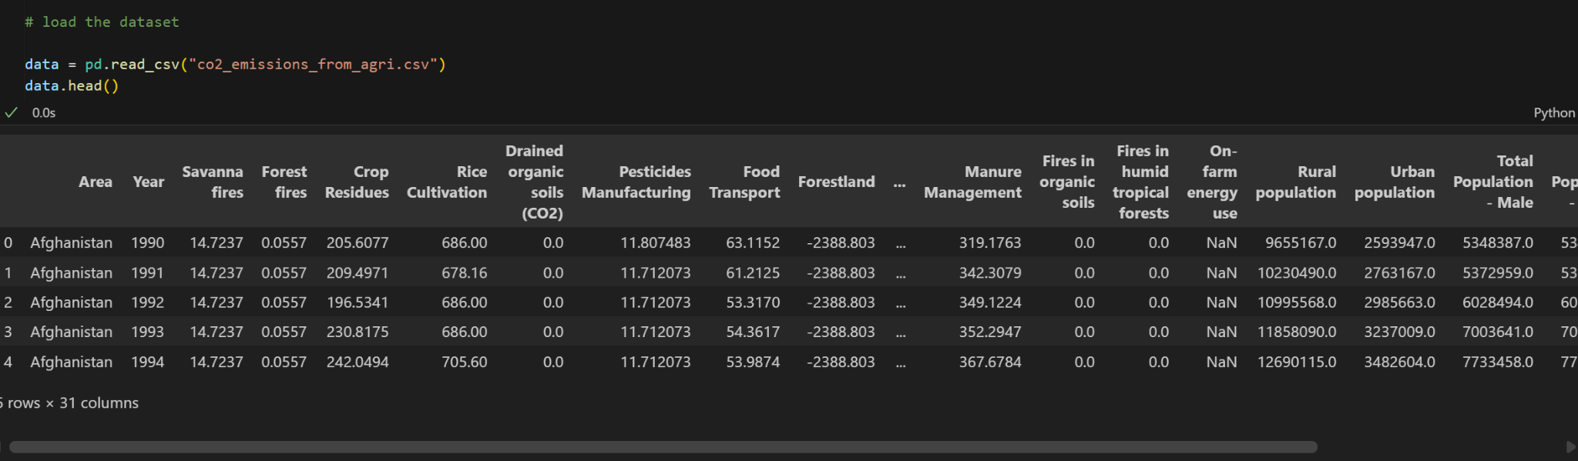
Dataset Overview
The dataset had around 7000 rows and 30+ columns.
It included information such as:
Fires, emissions, fertilizer use, and population
Target variable: Average Temperature ©

Slide 4
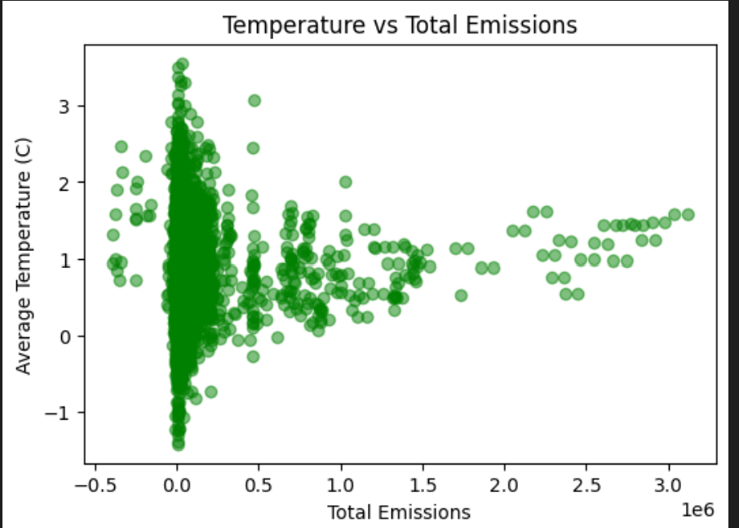
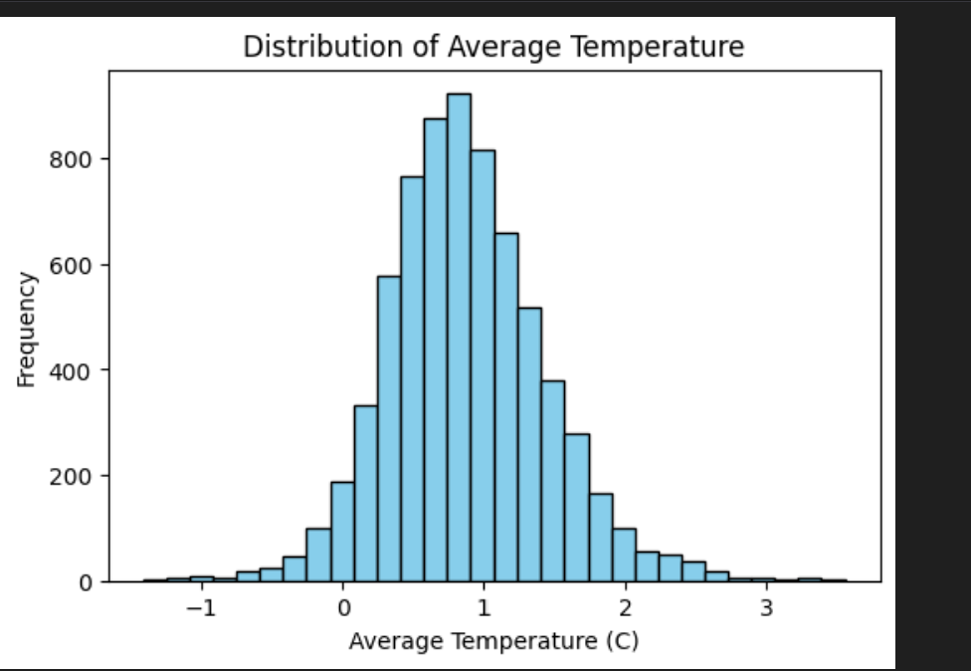
Exploratory Data Analysis (EDA)
Checked data summary and correlations .
Found Year had the strongest correlation with temperature
Some features (like food transport, retail, IPPU) showed small positive links
Visualized data with histograms and scatter plots.

Slide 5
Steps Taken
Loaded and cleaned the data
Filled missing values
Renamed and organized columns
Performed Exploratory Data Analysis (EDA)
Trained three regression models
Compared results and selected the best one

Slide 6
Models Used
Linear Regression – baseline model
Ridge Regression – improved linear model
Random Forest Regressor – tree-based model that captures complex patterns

Slide 7
Model Results
Linear Regression -> R2: 0.516, MAE: 0.285, RMSE: 0.385
Ridge Regression -> R2: 0.517, MAE: 0.286, RMSE: 0.385
Random Forest -> R2: 0.640, MAE: 0.244, RMSE: 0.332
Random Forest performed the best with the highest R² and lowest errors.
It was chosen as the final model.

Slide 8
Key Insights
Temperature increases slightly with Year and emission-related activities.
Random Forest showed that features like energy use, food transport, and industrial processes (IPPU) were more important predictors.
These results can help policymakers understand how agricultural systems affect climate.

Slide 9
Tools and CollaboratioN
The Random Forest model gave the best predictions.
The project showed how agricultural and industrial factors influence temperature.
Using data like this can support climate planning and sustainable agriculture.
Project completed successfully with collaboration tools and proper workflow

Slide 10
Conclusion
The Random Forest model gave the most accurate predictions.
The analysis showed how agricultural and industrial factors affect temperature.
The project helped me apply regression concepts in a real-world context.
Tools like Trello, GitHub, and VS Code improved workflow and collaboration.

